Slide 1
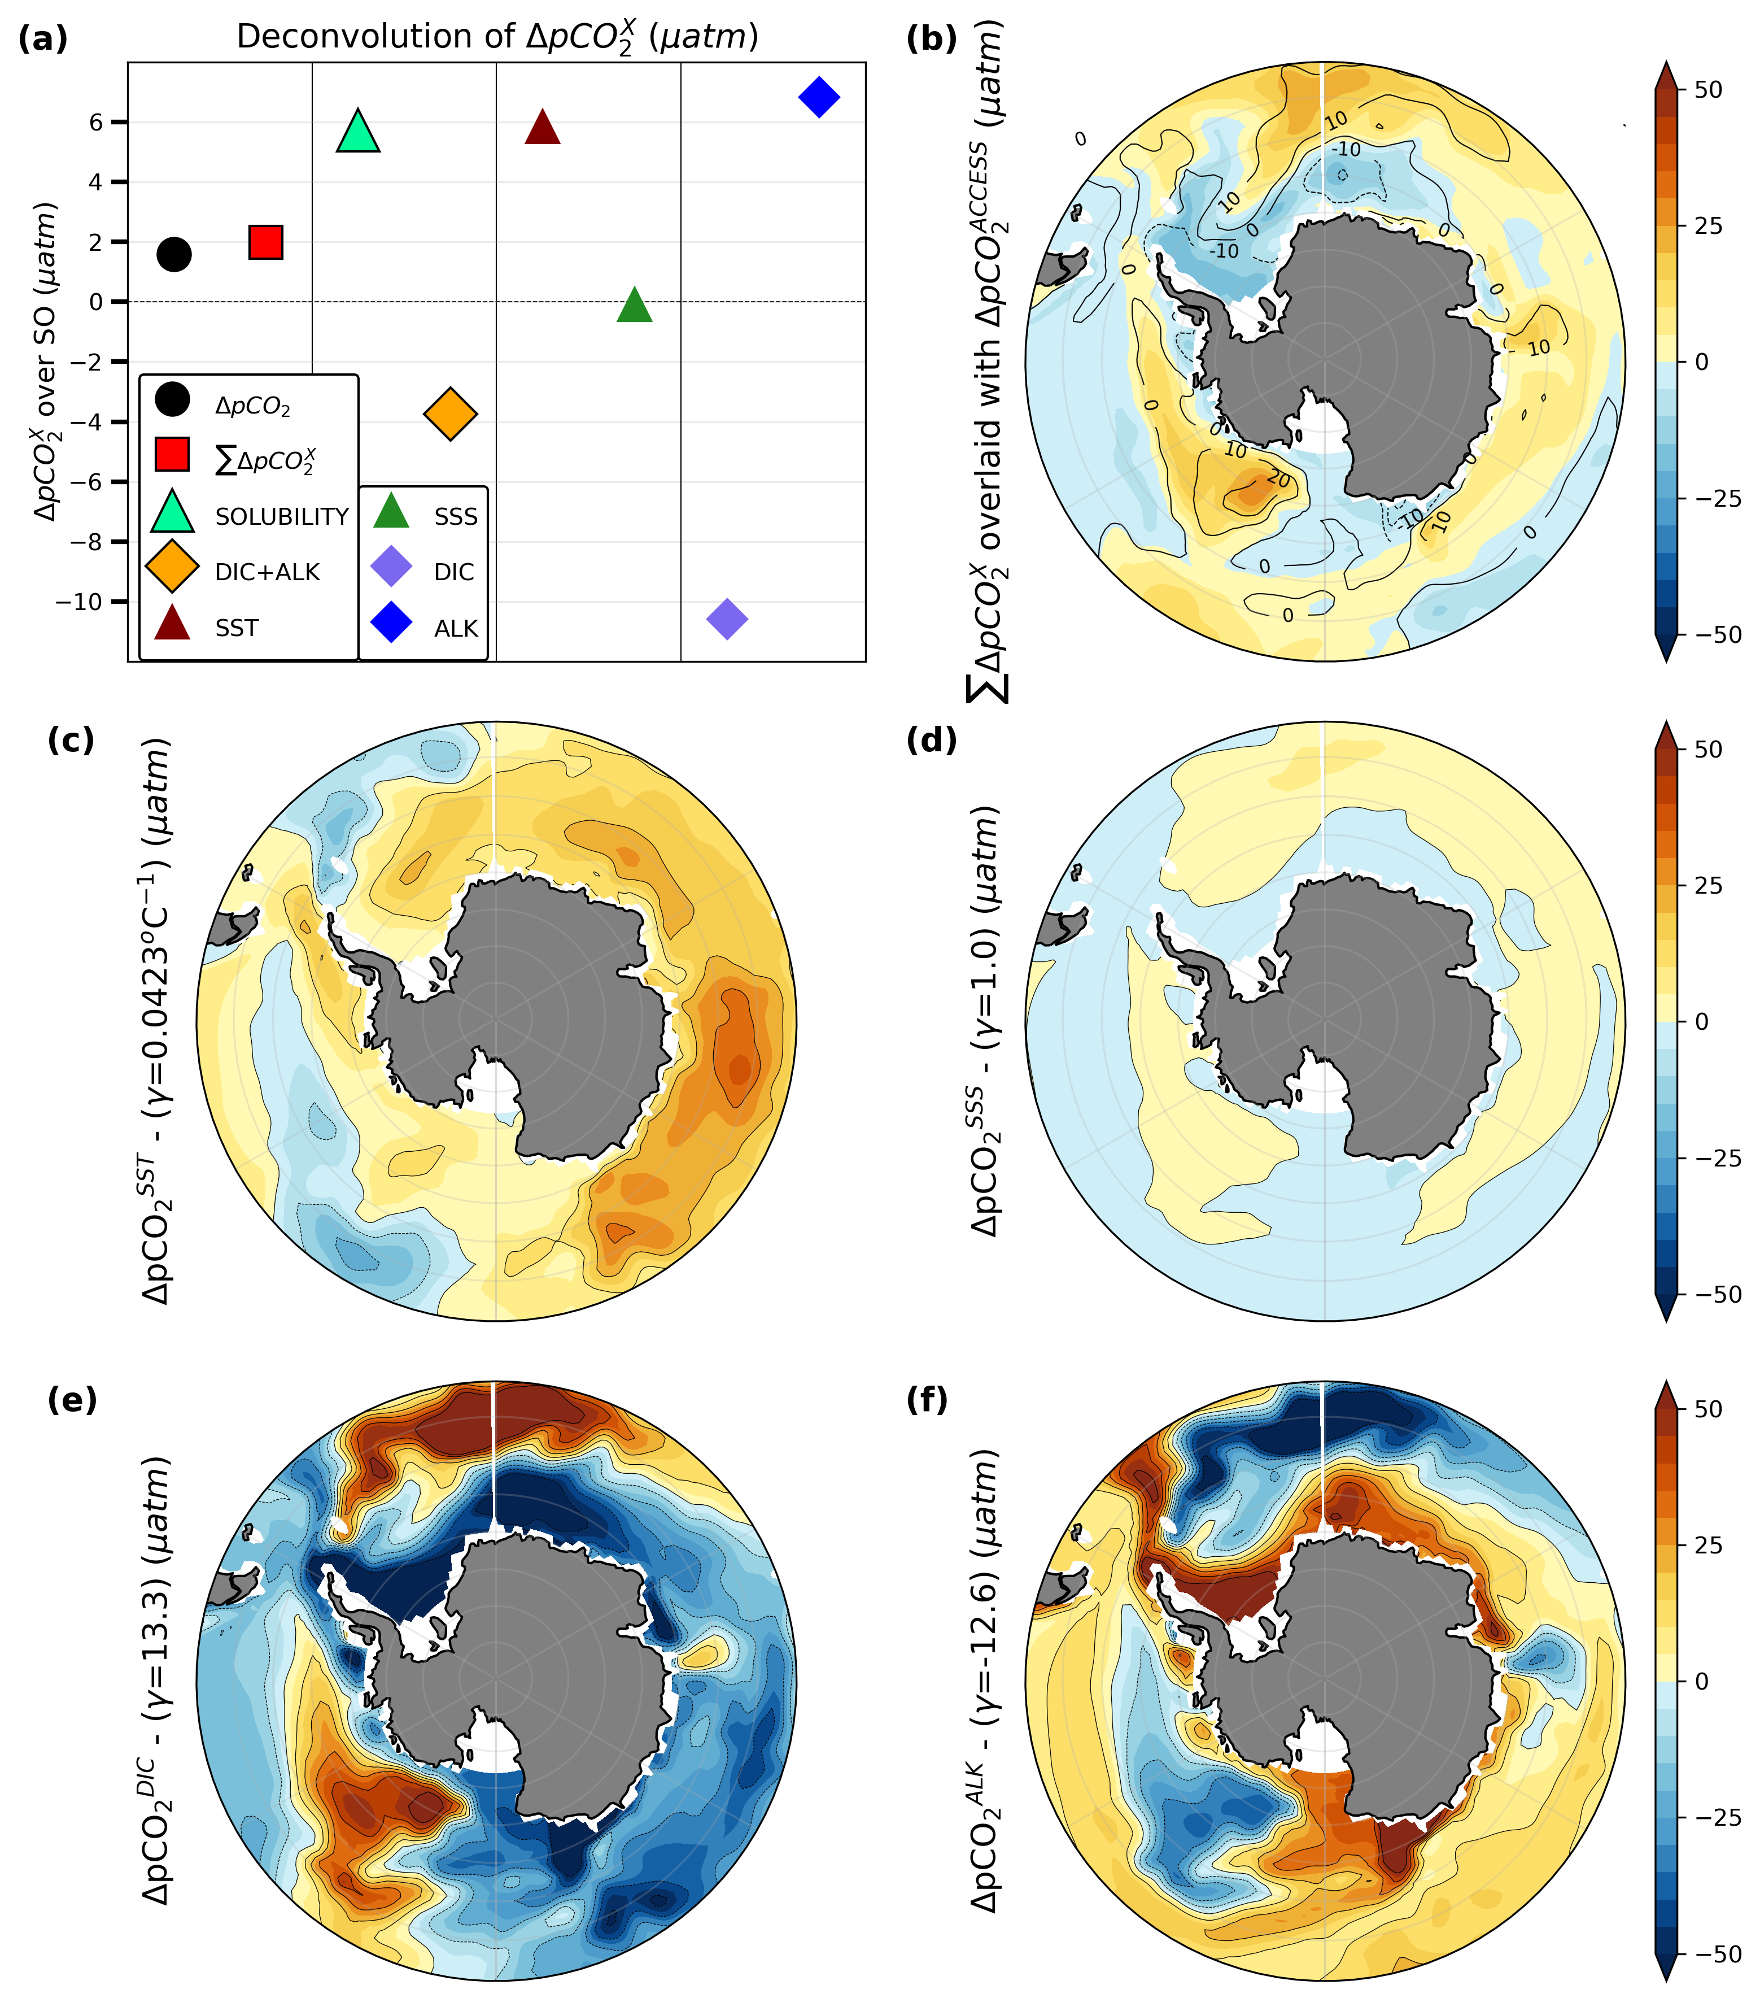
Carbon cycle feedbacks in a warmer Southern Ocean
Dr. Dipayan Choudhury¹
Laurie Menviel¹, Katrin J. Meissner^{1,2}, Nicholas K.H.Yeung^{1,2}, Matthew Chamberlain³, and Tilo Ziehn⁴
¹ Climate Change Research Centre, University of New South Wales, Sydney NSW, Australia
² ARC Centre of Excellence for Climate Extremes, University of New South Wales, Sydney NSW,Australia
³ CSIRO Oceans and Atmosphere, Hobart TAS, Australia
⁴ CSIRO Oceans and Atmosphere, Aspendale VIC, Australia
Notes:
Understanding how the carbon cycle behaves in warmer world is critical to better constrain future warming
Simulations unequivocally suggest warming - pronounced at high latitudes
To understand this, we look at a period from the paleoclimate

Slide 2
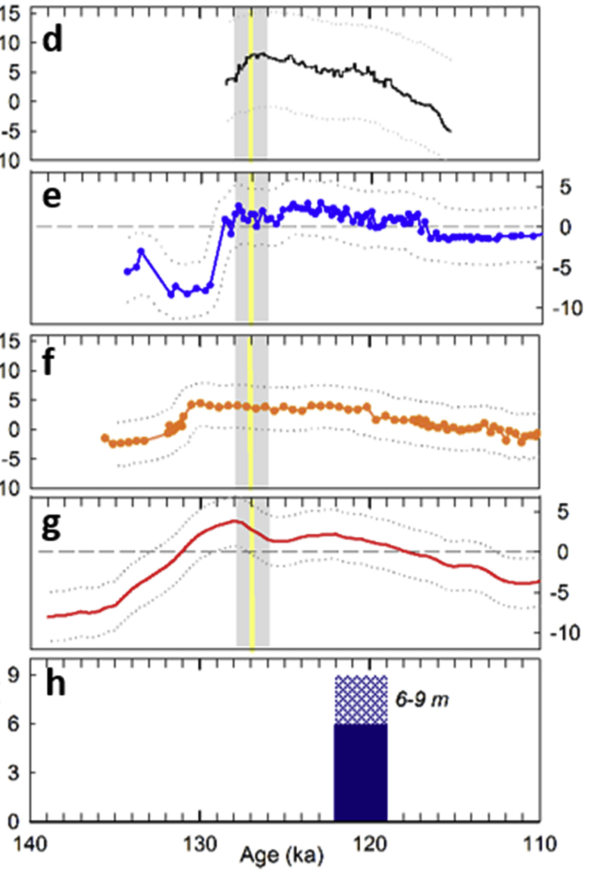
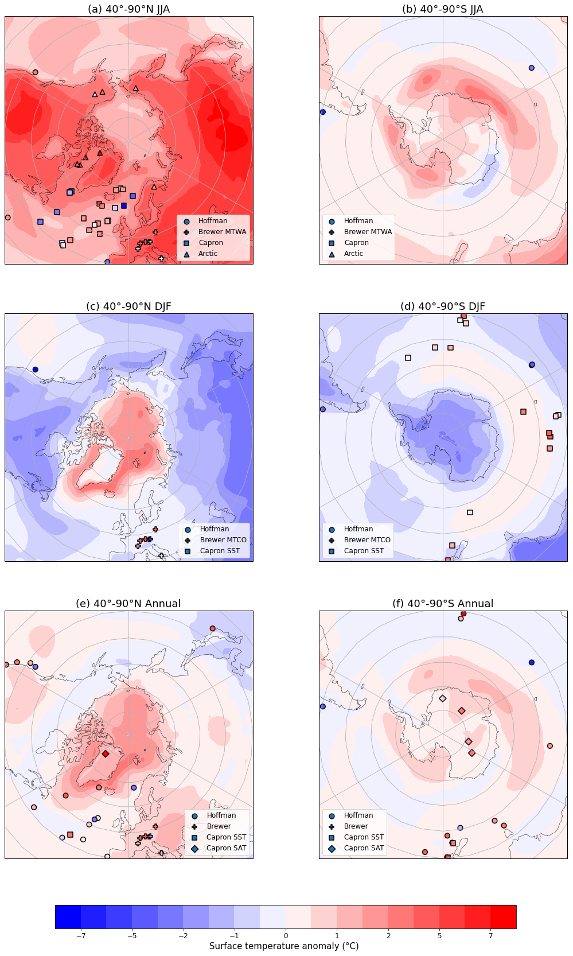
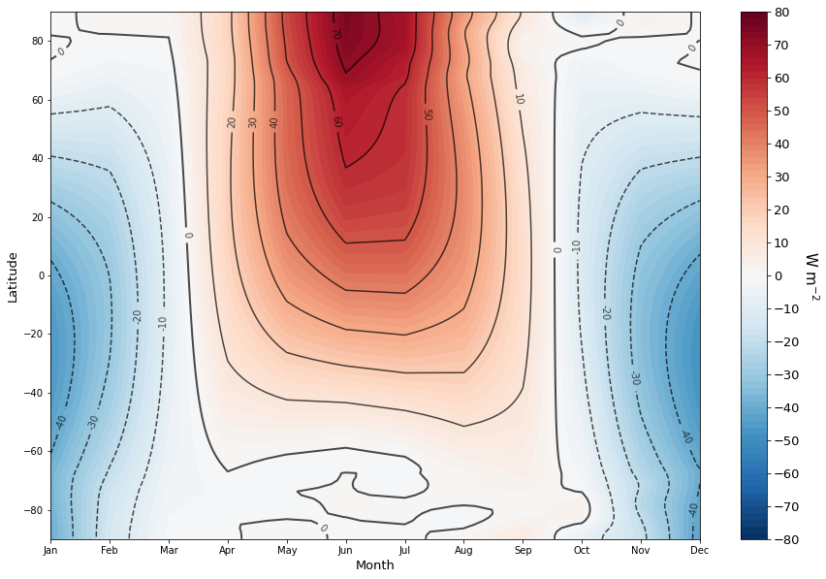
The Last Interglacial (127ka)
Simulations
Reconstructions
Greenland
N. Atlantic
S. Ocean
Antarctica
Sea Level
Warm period – with high latitude warming
Insolation driven: High eccentricity, obliquity and NH summer close to perihelion – CO₂ neutral
Yeung, N. K.-H., Menviel, L., Meissner, K. J., Taschetto, A. S., Ziehn, T., & Chamberlain, M. (2021). Land–sea temperature contrasts at the last interglacial and their impact on the hydrological cycle. Climate of the Past, 17(2), 869–885.
Otto-Bliesner, B. L., Brady, E. C., Zhao, A., Brierley, C. M., Axford, Y., Capron, E., Govin, A., Hoffman, J. S., Isaacs, E., Kageyama, M., Scussolini, P., Tzedakis, P. C., Williams, C. J. R., Wolff, E., Abe-Ouchi, A., Braconnot, P., Ramos Buarque, S., Cao, J., de Vernal, A., Guarino, M. V., Guo, C., LeGrande, A. N., Lohmann, G., Meissner, K. J., Menviel, L., Morozova, P. A., Nisancioglu, K. H., O’ishi, R., Salas y Mélia, D., Shi, X., Sicard, M., Sime, L., Stepanek, C., Tomas, R., Volodin, E., Yeung, N. K. H., Zhang, Q., Zhang, Z., and Zheng, W.: Large-scale features of Last Interglacial climate: results from evaluating the lig127k simulationsfor the Coupled Model Intercomparison Project (CMIP6) –Paleoclimate Modeling Intercomparison Project (PMIP4), Clim.Past, 17, 63–94, https://doi.org/10.5194/cp-17-63-2021, 2021.
Notes:
Warming in Gr, NAtl, SO, Ant
Sea level was higher than now
However, insol driven
Nevertheless, models simulate high lat warming akin to future sim
Hence, provides an excellent testbed for effects of warm climate

Slide 3
lig127k equilibrium simulation
Understand the carbon cycle in a warmer ocean
Specifically, a warmer Southern Ocean
WOMBAT includes two simultaneous tracers:
Prescribed CO₂ (284.3 for PI and 275 for LIG)
Constant CO₂ of 280ppm:
This helps quantify the effects of climate, independent of the background CO₂ state
PI ~1000 years; LIG ~650 years
Notes:
Highest priority expts of PMIP4
Some parameters presented here to show insol high - co2 low
To mitigate effects of prescribed co2 on carbon cycle

Slide 4
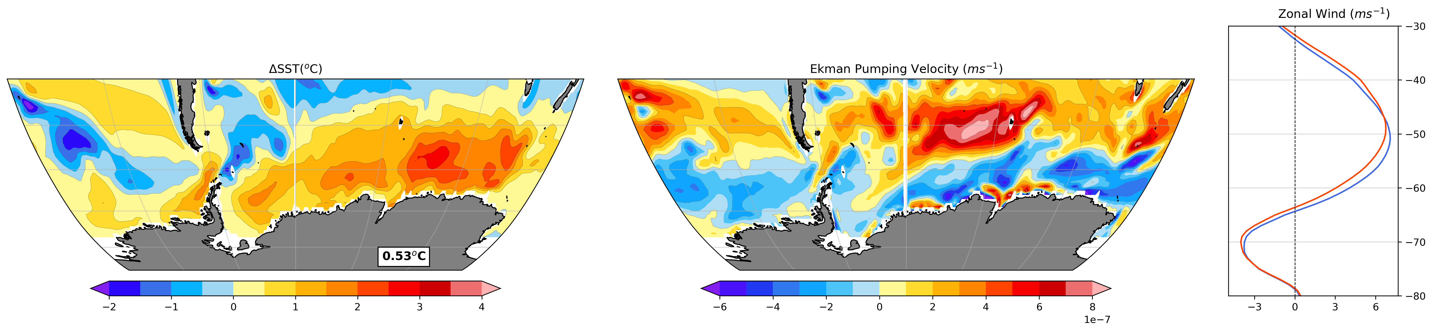
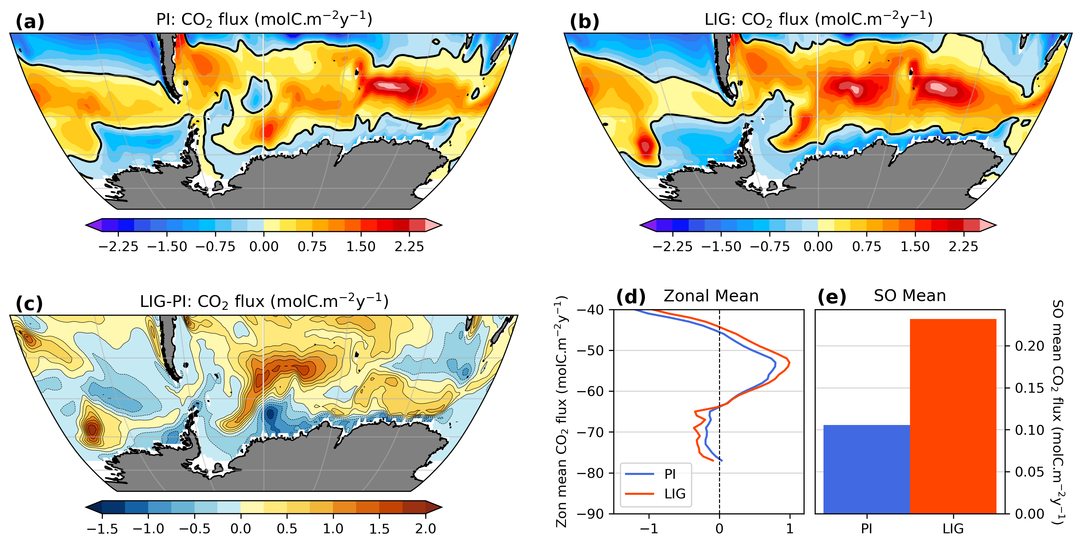
Physical changes and CO₂ flux
SST (℃)
Ekman Pumping (ms⁻¹)
1.5˚
10%
Net increase in CO₂ outgassing over SO, but spatial variations
120%
Notes:
High latitude SST warming - with magnitudes consistent with previous modelling studies and reconstructions
Increased upwelling over subpolar to subtropical regions - coinciding with the shift and weaking of winds
The corresponding CO2 flux shows increased outgassing north of 65S - with net magnitude higher by 120%
Rest of the talk focusses on understanding this

Slide 5
Sea surface pCO₂ decomposition
SST
SSS
DIC
ALK
Decompose into contributions from:
Notes:
Increase around 55S – decrease in Weddell and Ross Seas, subantarctic east Pacific
We can attribute this pattern using Revelle factors
SST – increase over coastal Indian and West Pacific Oceans
DIC – decrease over coastal areas, but increase over subantarctic Indian and Amundsen Sea sectors
Part of the DIC changes compensated by ALK - as we will see next

Slide 6
pCO₂ decomposition summary
SST and DIC compete, resulting in net increase in pCO₂
Notes:
Net pCO2 is higher - hence the outgassing
Sol increases outgassing - which is compensated by the DIC+ALK term
And primary contributors to these are SST and DIC

Slide 7
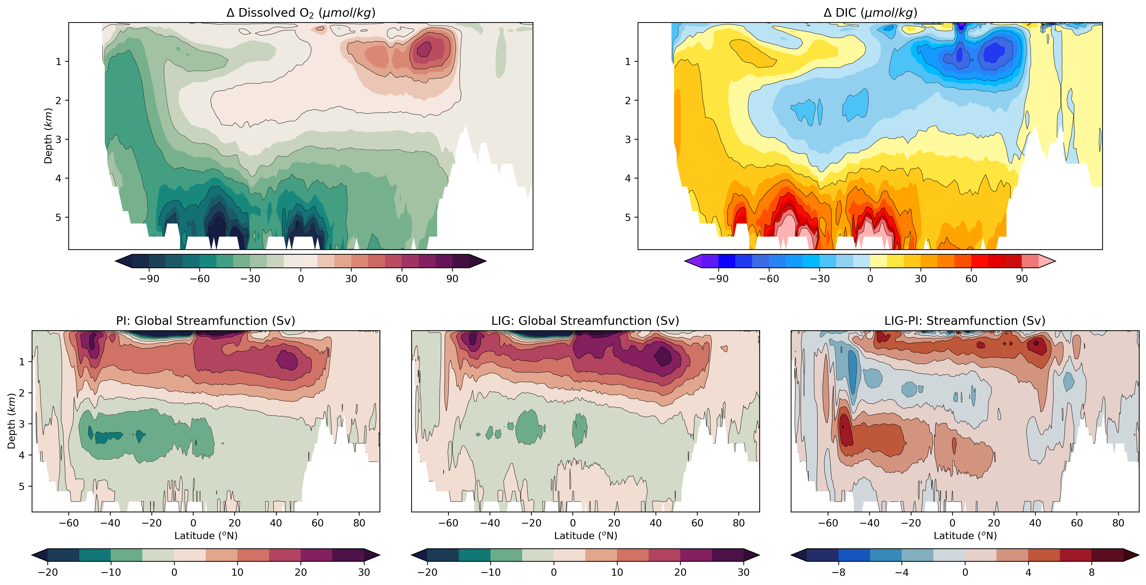
Deep ocean changes
O₂
DIC
Reduced ventilation – increased remineralization and storage at depth
NADW: +5Sv
AABW: -4Sv
AAIW formation: Northward
Deep water temp: +2˚C
Reduced bottom water circulation:
Reduced SO ventilation
Increased residence times
Higher efficiency of the biological pump
Notes:
We have already looked at SST - to understand DIC, we look at the deep ocean
Clear sequestration of DIC and depletion of O2 in the deeper water -
implies bio pump
which could be driven by changes in circulation
NADW increases by ~5Sv
AAIW regions shift northward
AABW formation reduces by ~4Sv
Increased residence times leads to a stronger bio pump

Slide 8
Stronger outgassing at LIG compared to PI
Primarily driven by SST
Partly compensated by DIC: circulation changes and a more efficient biological pump
Dr. Dipayan Choudhury
d.choudhury@unsw.edu.au
¹ Climate Change Research Centre, University of New South Wales, Sydney NSW, Australia
² ARC Centre of Excellence for Climate Extremes, University of New South Wales, Sydney NSW,Australia

